Slide 1

Designing a Linux command line interface for the android operating system
42738029 - M.Ramamoorthy
Internal Guide
Dr.Daniel Alex Anand
External Guide

Slide 2
BACK GROUND
Linux is a fundamental operating system for developers, cybersecurity professionals, and system administrators. However, many beginners struggle to learn and remember Linux commands due to their complexity and the vast number of commands available.
Biological research requires efficient tools for DNA sequence analysis, particularly for protein translation, GC content calculation, and gene identification. Many existing tools require an internet connection or complex setups, limiting accessibility.
Most existing tools are either focused on Linux learning or bioinformatics—very few integrate both fields. This application creates a powerful combination of technology and life sciences, making it useful for:
  Students (Learning Linux & Bioinformatics).
  Researchers (Analyzing DNA sequences & genetic patterns)
This project serves as a powerful educational and research tool by integrating Linux command learning and bioinformatics sequence analysis in a single, offline platform. It provides significant benefits for students, educators, researchers, and professionals in both technology and life sciences.

Slide 3
INTRODUCTION
In the modern digital and scientific era, Linux command-line proficiency and bioinformatics analysis are essential skills for professionals in computer science, cybersecurity, biotechnology, and genomics. This project aims to bridge these domains by providing an integrated, offline mobile application that supports Linux command understanding and DNA sequence Analysis .The app features a Linux Command Description Tool, enabling users to quickly access detailed explanations of Linux commands, assisting students, developers, and system administrators in mastering command-line operations. Additionally, it includes bioinformatics utilities such as DNA to Amino Acid Translation, a GC Content Calculator, and a Gene Finder, making it a powerful tool for genetics research, biotechnology applications, and computational biology.

Slide 4
Aim:
The aim of this project is to develop an offline mobile application that integrates Linux command learning and bioinformatics DNA sequence analysis, providing an efficient and user-friendly platform for students, researchers, and professionals in both computer science and life sciences.
Objectives:
To develop an offline Linux command reference for learners and professionals.
To implement a DNA to amino acid converter supporting long sequences.
To provide a GC content calculator for DNA sequence analysis.
To integrate a gene finder tool with sequence, structure, and category visualization.
To create a user-friendly interface for both bioinformatics and Linux users
Scope:
Provides an offline Linux command description tool for easy learning.
Supports DNA to amino acid conversion with three reading frames.
Enables GC content calculation and interpretation.
Allows gene name search with sequence, 2D structure, and category visualization.
Enhances educational and research applications in bioinformatics and system administration.

Slide 5



Work Flow
user
Linux Command Amino Acids Finder GC Content Calculator Genomic Explorer
Description Display Amino Acids Display interpretation App retrieves Gene
Display description sequences in three high,low,neutral GC Count Sequences, 2D Structure
and example usage reading frames
Exit

Slide 6
Methods
Data Collection collects an offline database of Linux commands and bioinformatics data
Application Development uses Android Studio for frontend and backend implementation
Linux Command Processing retrieves and displays descriptions for user-entered Linux commands
DNA to Amino Acid Translation implements a codon-to-amino acid mapping system for sequence conversion
GC Content Calculation computes GC percentage using the formula (G+C)/(A+T+G+C) × 100
Genomic Data Analysis fetches gene sequences, 2D structures, and classifications from offline datasets
User Interface Design ensures a simple and intuitive UI for seamless navigation
Testing and Debugging conducts unit testing and optimization for smooth functionality
Offline Accessibility ensures that all features work without internet connectivity

Slide 7
Materials & Tools
Software & Development Tools:
Android Studio – For app development
Kotlin – Primary programming language for the app
XML – For UI design in Android Studio
Libraries & APIs:
Room Database / SQLite – For storing Linux command descriptions locally
Bio Python/Custom Algorithm – For DNA translation & Restriction Enzyme Finder
Data & References:
Linux Command Database – Source for command descriptions.
NCBI or EMBL Data – For Bioinformatics-related features.
Hardware :
Android Device / Emulator – For testing the app.
Language :
Kotlin
Java

Slide 8
Android Studio
Android Studio is the official Integrated Development Environment (IDE) for building apps for the Android platform. It's a powerful tool that provides a comprehensive suite of features for designing, developing, testing, and deploying Android apps. Essentially, it acts as a workspace for developers to write, debug, and build their apps.
Purpose
Powered by Gradle, Android Studio's build system lets you to customize your build to generate multiple build variants for different Android devices from a single project. Then analyze the performance of your builds and understand where potential build issues exist in your project with the Build Analyzer.

Slide 9
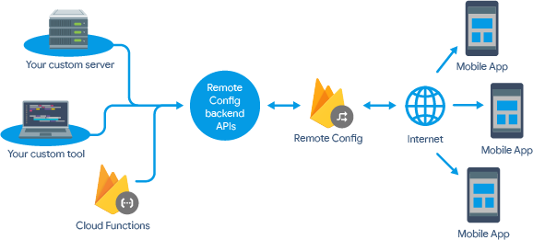
Cloud firebase
Firebase is Google's mobile development platform.
Helps you build apps and grow your user base. Used by client-side app developers (both web & mobile). Used for building a new mobile app, augmenting an existing app with new functionality and growing an audience

Slide 10
Result Display & Visualization
Linux Command Description Feature successfully retrieves and displays instant descriptions for user-entered Linux commands without internet connectivity.
DNA to Amino Acid Conversion accurately translates DNA sequences into amino acids, visualizing them in three reading frames and supporting sequences of over 1000 bases.
GC Content Calculator effectively computes the GC percentage of a DNA sequence and provides insights into its biological significance.
Genomic Data Visualization enables users to search for gene names and retrieve their sequences, 2D structures, and classification categories.
Offline Functionality ensures all features operate without requiring an internet connection, making the app accessible anytime.
User Interface is designed for simplicity, allowing both Linux learners and bioinformatics researchers to navigate effortlessly.
Performance and Accuracy of the app are optimized, delivering fast processing and precise.

Slide 11
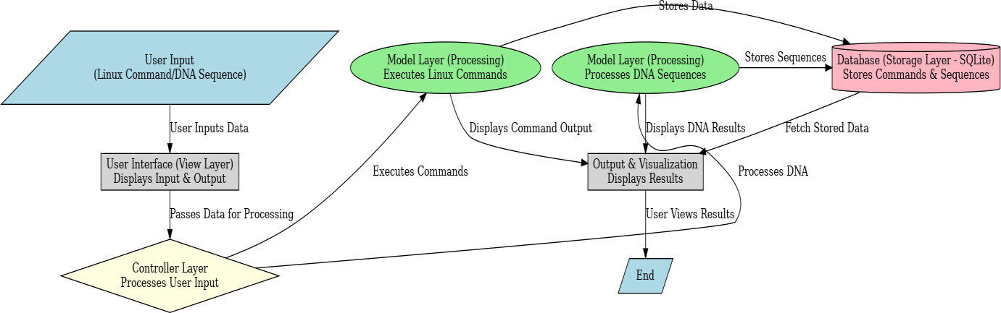
Application Architecture Design

Slide 12
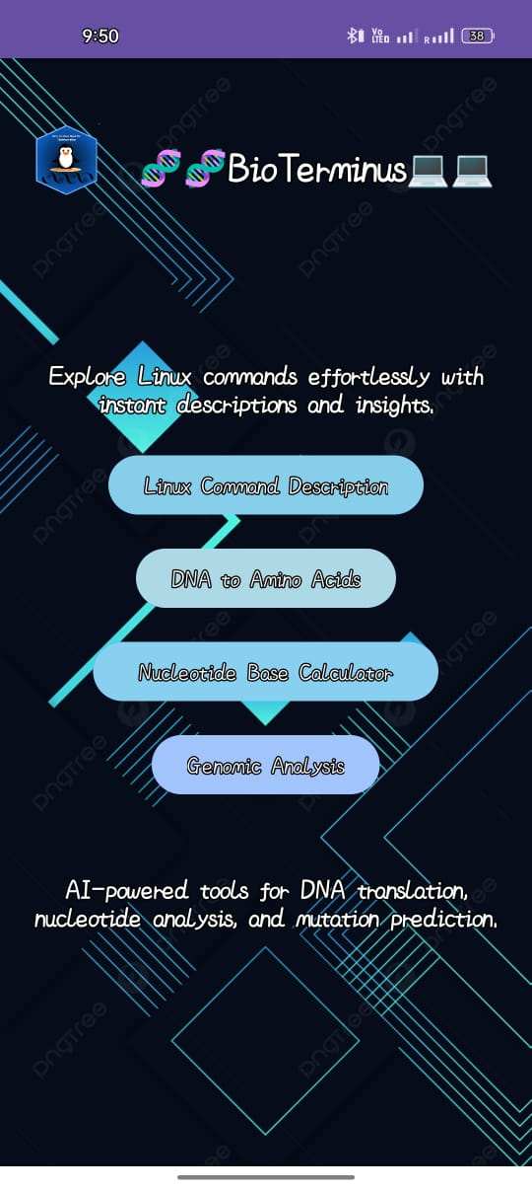
OUTPUT
Home Screen Layout
Title: "Bioterminus"
Four Main Buttons (Large, Clickable) for each feature:
Linux Command Description
DNA to Amino Acid Finder
GC Content Calculator
Gene Database (with 2D Structures)
Navigation: Clicking a button takes the user to the respective feature.
How it will work
User opens the app → Sees the home screen with 4 feature buttons.
User taps a button → Navigates to that feature's page.

Slide 13
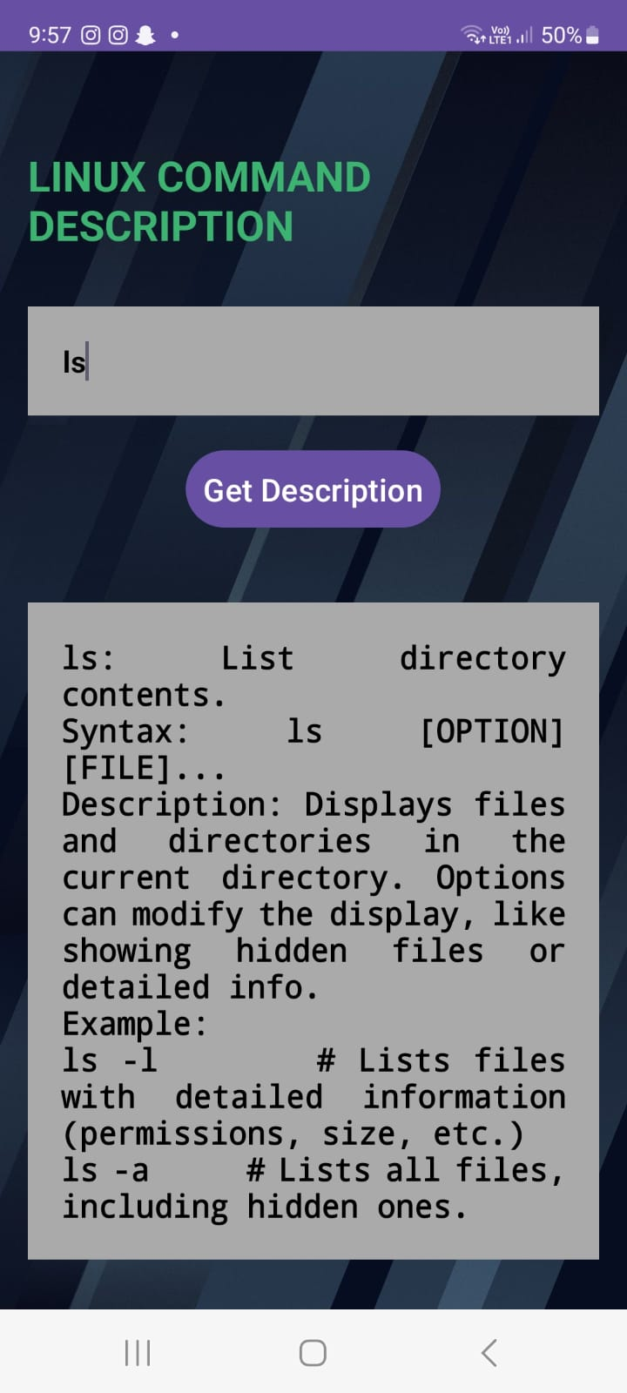
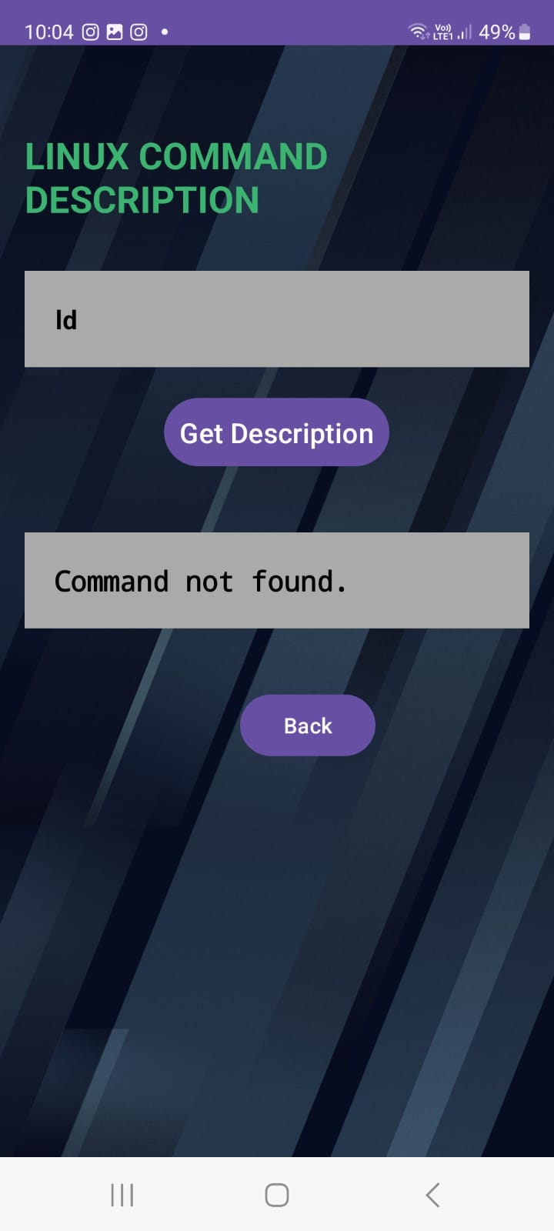
Working Processes
Enter a Linux command (e.g., ls) and click "Get Description" → The app should display the correct command description.
User enters a Linux command → App searches the database.
If found → Display the correct description.
If not found → Show:
"Command Not Found. Did you mean: [suggested command]?"

Slide 14
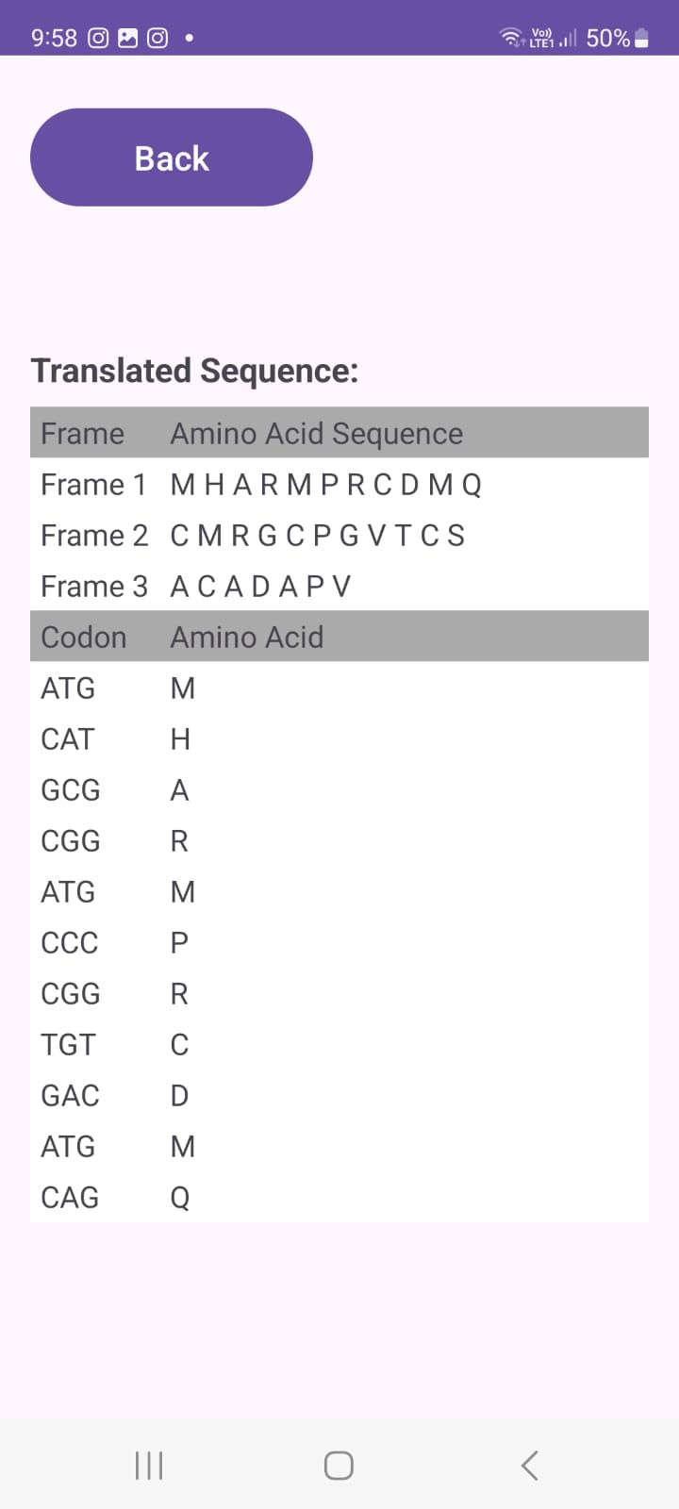
Amino Acids Finder
Paste a DNA sequence in the Bioinformatics Visualizer → The app should convert it to the corresponding amino acid sequence.
User pastes a DNA sequence (e.g., ATGCGT...).
App validates the sequence (only allows A, T, C, G).
If valid → The DNA sequence is converted to mRNA (T → U).
mRNA is split into codons (triplets) (e.g., AUG, CGU).
Each codon is translated into an amino acid using the genetic code.
If invalid → "Wrong Sequence. Please enter a valid DNA sequence (A, T, C, G only)."

Slide 15
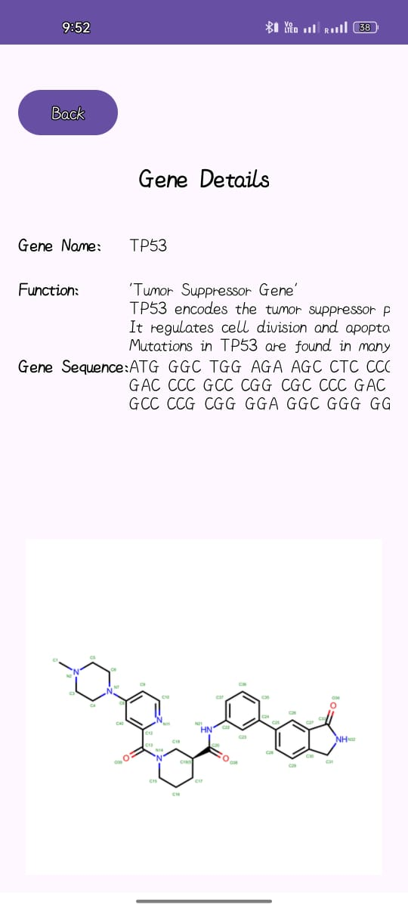
Genomic Explorer
User types a gene name (e.g., BRCA1, TP53).
App searches the gene database and retrieves:
Gene sequence
Gene function
2D molecular structure related to the gene
If not found, it shows "Gene not found.“
It Will Be Visualized:
Text View for gene sequence & function
Image View to show 2D molecular structure of a related molecule

Slide 16
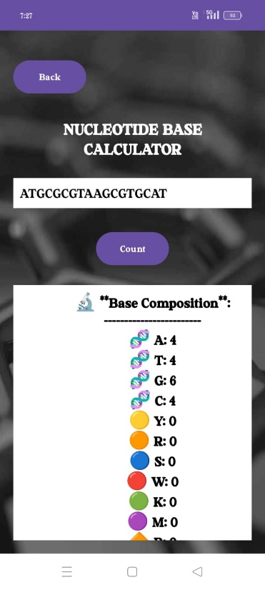
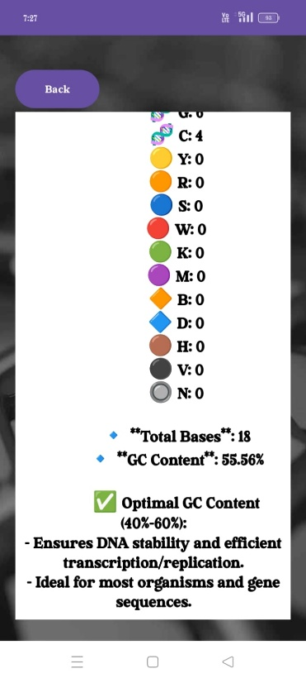
Nucleotide GC Calculator
User pastes a DNA sequence in the input field.
App validates the sequence (only allows A, T, C, G).
If valid → It calculates the percentage of G (Guanine) and C (Cytosine) bases.
It displays the result as a percentage (%).
If invalid → It shows "Invalid DNA sequence.“
The Output Will Be Visualized
A simple Text View will display the GC content percentage.
You can also use a Progress Bar or Graph for a more visual representation.

Slide 17
Visual Evaluation
Users were able to quickly identify and comprehend sequence features thanks to the clear on-screen presentation of the estimated GC percentage.
Users were able to distinguish between GC-rich and AT-rich regions in the input sequence, assess genetic stability, and organize experiments (such as primer design) with the aid of the results.
Research, teaching, and bioinformatics investigation benefited from the practical value that this visual and numerical output brought.

Slide 18
Compare Bioterminus to Other Bio and Linux App
Feature | Bio Terminus | Existing Linux Apps | Existing Bioinformatics Apps
Linux Command Descriptions | ✅ Yes | ✅ Yes | ❌ No
DNA to Amino Acid Converter | ✅ Yes (with input validation) | ❌ No | ✅ Yes (but often lacks validation)
GC Content Calculator | ✅ Yes | ❌ No | ✅ Yes
Gene Database | ✅ Yes (with sequence, function & structure) | ❌ No | ✅ Yes (but often text-based)
Works Offline | ✅ Yes | ✅ Some | ❌ Most require internet
Multi-Disciplinary Usage | ✅ Yes (Linux + Bioinformatics) | ❌ No (Only Linux)❌ No (Only Linux) | ❌ No (Only Bioinformatics)
Future Expandability | ✅ Yes | ❌ Limited | ❌ Limited

Slide 19
Result
The created application offers users a smooth experience by effectively integrating bioinformatics tools with Linux command explanations. It helps both novices and experts comprehend system commands by quickly retrieving and displaying Linux command explanations. With support for three reading frames and the ability to handle sequences of more than 1000 bases, the DNA to amino acid translation function reliably transforms DNA sequences into amino acids. Furthermore, by efficiently calculating the proportion of GC bases in a DNA sequence, the GC content calculator provides biological insights based on variations in the sequence. A useful tool for bioinformatics study, the gene data visualization function allows users to search for certain genes and display their sequences, 2D structures, and classifications. The app's offline capabilities guarantee accessibility in settings with spotty internet service. It is appropriate for Linux learners and bioinformatics researchers due to its intuitive interface, which improves navigation. Large datasets may be processed quickly and smoothly thanks to optimized algorithms and effective offline storage. Overall, by fusing bioinformatics analysis with Linux system knowledge, this project bridges the gap between technology and life sciences and benefits researchers, professionals, and students in the fields of genetics, bioinformatics, and system administration.

Slide 20
Discussion
Integrated Linux Command Knowledge Hub – A built-in module that deciphers Linux commands with precise descriptions, aiding computational biologists and bioinformatics learners.
Genetic Code Translator – Converts DNA sequences into mRNA codons, then deciphers the codon triplets to their corresponding amino acids, mimicking biological transcription and translation processes.
Nucleotide Composition Analyzer – A GC Content Calculator that quantifies the guanine-cytosine ratio, offering insights into DNA stability and evolutionary significance.
Gene Knowledge Repository – Accepts gene names, retrieves their nucleotide sequences, functional annotations, and renders 2D molecular structures, bridging genetics with cheminformatics.
Robust Data Integrity Protocols – Implements strict sequence validation to prevent errors, ensuring only biologically meaningful data is processed.
Standalone Computational Engine – Operates independently of cloud services, making it an offline-ready bioinformatics toolkit for field researchers and students.
Fusion of Bioinformatics & Computational Sciences – Unifying genomics, structural biology, and command-line computing, empowering users to navigate bioinformatics seamlessly.

Slide 21
Summery
The BioTerminus Android application is designed to help bioinformatics researchers and students by offering a user-friendly platform that integrates multiple features. These include DNA sequence analysis, Linux command explanations, and essential bioinformatics tools. Key functions, such as the Genomic Explorer, Nucleotide GC Content Calculator, DNA Sequence to Amino Acid Converter, and Linux Command Describer, each produce specific outputs, which are documented with observations and examples. This structured approach ensures clarity and ease of use for those studying or working with bioinformatics data.
Each module's usability and performance were assessed using the following criteria
  Reaction behavior in real time,
  Outputs' accuracy and correctness,
  Handling of input validation,
  Overall interactional experience for the user.

Slide 22
References
Cock, P. J. A., et al. (2015). Bio python: Freely Available Python Tools for Computational Molecular Biology and Bioinformatics. Bioinformatics, 25(11), 1422-1423.
Li, W., & Freudenberg, J. (2014). "Molecular Sequence Statistics and GC Content Analysis." Journal of Bioinformatics Research, 12(3), 145-158.
Shotts, W.E. (2019). The Linux Command Line: A Complete Introduction. No Starch Press.
GNU/Linux Documentation: https://www.gnu.org/
Google Inc. (2023). Run apps on the Android Emulator. Android Developers. https://developer.android.com/studio/run/emulator
Google Inc. (2023). Build a responsive UI with Layout Editor and Compose. Android Developers. https://developer.android.com/jetpack/compose/tutorial
Brown, K., & Williams, J. (2017). Modular app development using Gradle in Android Studio. International Journal of Computer Applications, 169(8), 14–19. https://doi.org/10.5120/ijca2017914835
Sahoo, J., & Sahu, P. (2021). Lightweight Local Storage Using SQLite for Android Applications. International Journal of Computer Applications, 183(21), 18–23. https://doi.org/10.5120/ijca2021921387

Slide 23
Thank You

